Slide 1

An algebraic hierarchy
Vector Space
A vector space, V, consists of vectors, which are collections of elements from a field, F, and scalars, which are elements of F.
Field
A field, F, is a commutative ring with identity; every element, except additive identity, has an inverse wrt. “x”
Ideal
An ideal is a subset of ring, with commutative “+” and
Ring
Rings are groups that support two binary operations, commutative “+” and “x”, with distribution of “x” over “+”.
Group
Groups are sets that support a single binary operation, with association a+(b+c)=(a+b)+c, identity and inverse. Not necessarily commutative
Set
Sets are collections of things.
Element
Elements are things, e.g., integers, polynomials, vectors,

Slide 2




Some examples
The set of all integers, , forms a group under normal addition
  It is closed
  It is associative
  It has an inverse and identity
The set of all integers, , does not form a field
  There is a multiplicative identity…
  …but multiplicative inverses don’t exist
  So it is a ring!
  Even integers are an ideal!
The set of all rational numbers does form a field…
…as do real numbers…and complex numbers.
The set of integers under modulo arithmetic may form a field under certain conditions

Slide 3
Galois Fields
Everiste Galois (1811-1832!) theory of roots of polynomial equations
A Galois Field is a field with a finite number of elements
We use the nomenclature GF(q) to indicate a Galois field with q elements
For the integers with modulo q arithmetic, GF(q) requires that q be a prime number!
The best-known and most used Galois Field is GF(2), the binary field!
For GF(q) in general, q must be a power of a prime.
The structure of GF(p^{m}) for powers-of-primes requires algebraic rules more complicated than simple integer modulo arithmetic

Slide 4


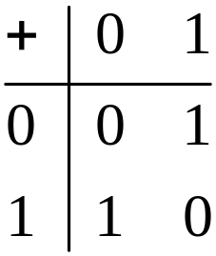
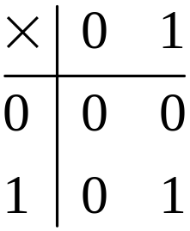


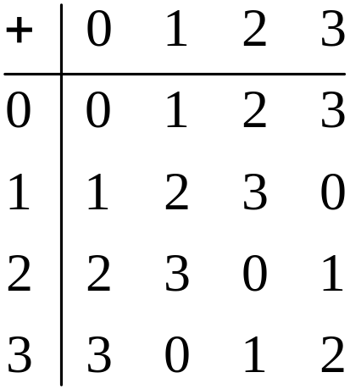
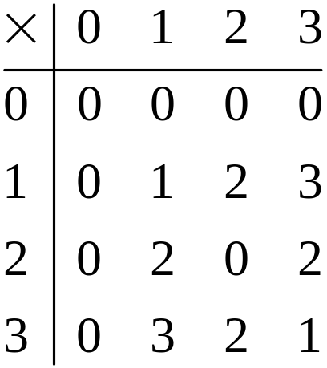
What is and isn’t a GF?
Simplest example,
Closed, associative & distributive from , additive identity, additive inverse, multiplicative identity, multiplicative inverse
What about ?

Slide 5





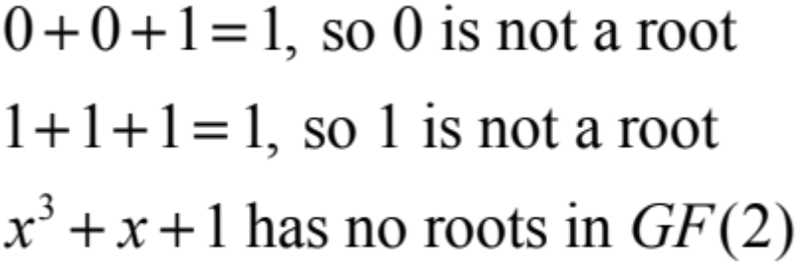


The GFAU Task: Operate in GF(2^{m})
Creating a “binary” Galois field
We write “the set of all polynomials with coefficients in GF(p)” as GF(p)[x]
Example
  is a polynomial in
  So is
Do these polynomials have roots in
  But has a root for
If a polynomial has no root in we call it irreducible

Slide 6

If an irreducible polynomial has another property (that we don’t need to worry about right now), it is not only “irreducible” but also “primitive”.
We can use m-th order primitive polynomials to generate
is such a primitive polynomial!
Because it is a 3rd order, primitive polynomial over , we can use it to generate
The primitive polynomial will be an input to the initialization of GFAU!
You don’t have to identify the primitive polynomials!

Slide 7








Let be a root of , so
The coefficients are in so
Note that is in the “big” field, but the coefficients of the polynomial are in the “little field”
must be in the big field, because a field has additive and multiplicative identities.
must be in the big field, by assumption
must be in the big field by closure of multiplication
must be in the big field, but
must be in the big field

Slide 8
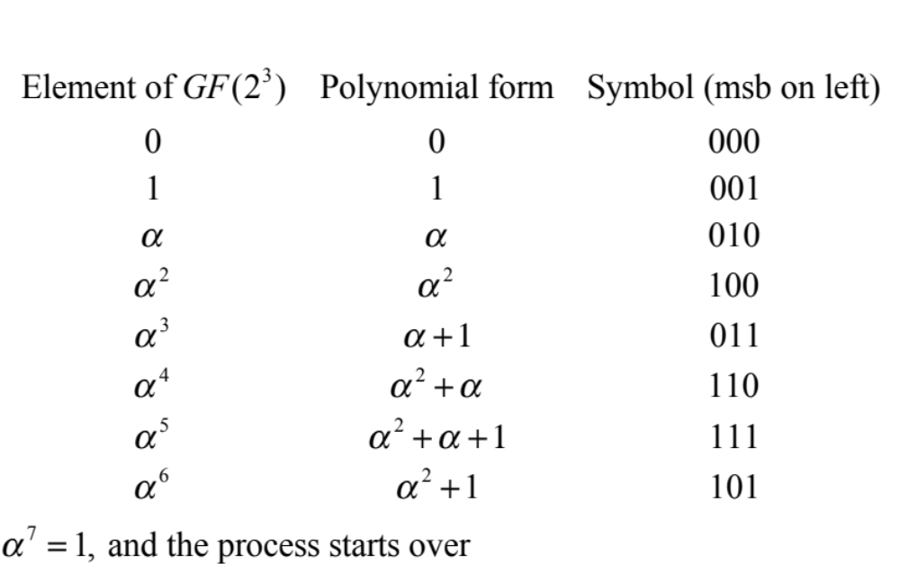

We now have polynomials in , where the coefficients are binary, that is
We write the symbols of as -element vectors in the “little field”,

Slide 9
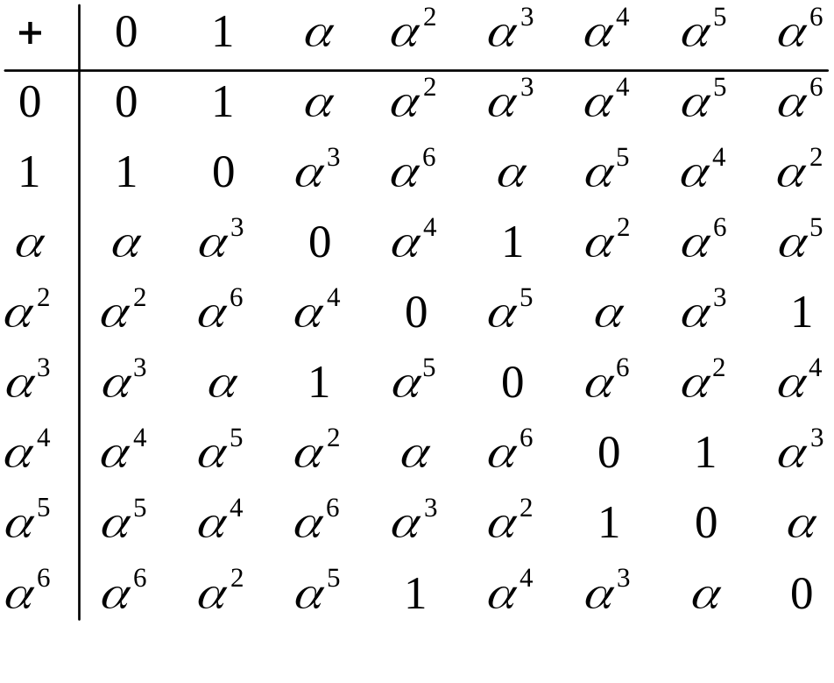
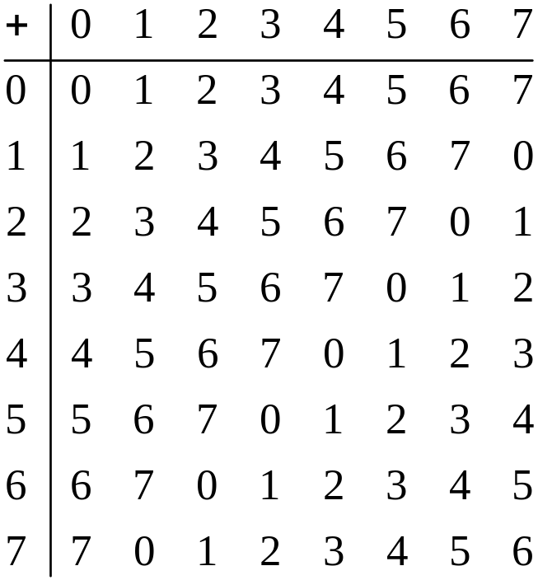



Addition table for GF(2³)
GF(2³)
Integers mod 8
For multiplication:
is called a primitive element of the field, because the powers of ____ generate the non-zero elements

Slide 10
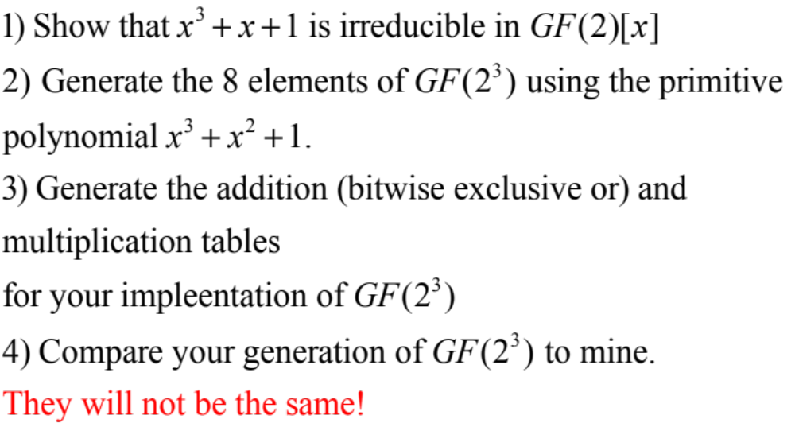
GFAU Homework
Generate

